Slide 1

1. TiGL Workshop – TiGL Viewer Scripting API + Hands On
Jan Kleinert, Martin Siggel
September 11./12. 2018, Cologne

Slide 2
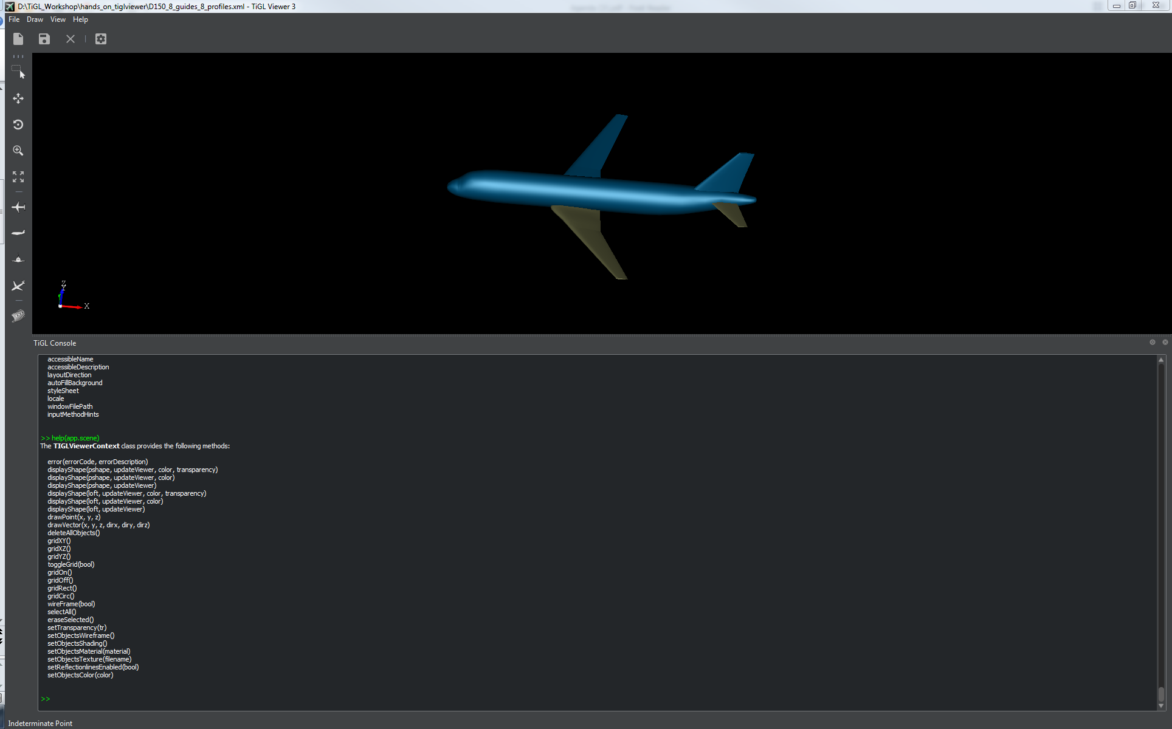
Contents
Introduction to the TiGL Viewer Scripting API
Hands On
CAD Export with customized export options
Display shapes by UID and make screenshots
Make a video with camera movement
Final Remarks

Slide 3
Introduction to the TiGL Viewer Scripting API

Slide 4
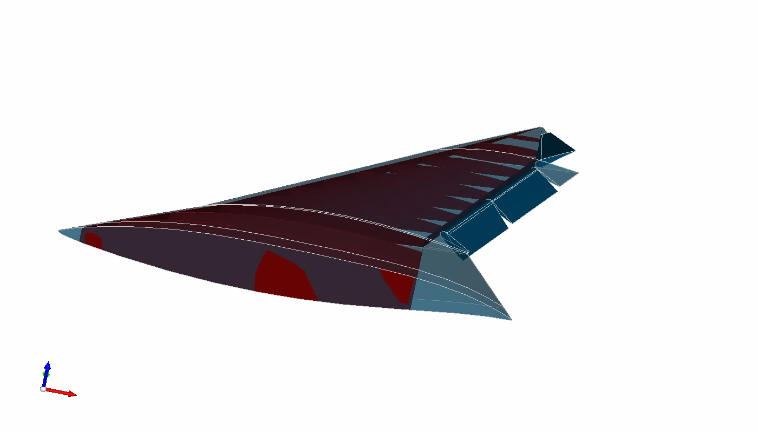

Introduction to the TiGL Viewer API
The TiGL Viewer comes with a separate scripting API based on JavaScript
It can be used for
Manipulating the visualization and creating screenshots and videos
Drawing (sub-) shapes, points and vectors
Accessing some of the basic TiGL API-functions

Slide 5
How to use the TiGL Viewer Scripting API
There are four ways to use the TiGL Viewer Scripting API
Open the Console in TiGL Viewer (Alt+C or View → Display → Console) and enter commands
Open the Console in TiGL Viewer (Alt+C or View → Display → Console) and enter:
Press File → Open Script and select a javascript file
Directly start TiGL Viewer from a terminal/command-prompt with a javascript file:
>> app.openScript(“myAwesomeTiGLViewerScript.js”)
$ D:\tiglhome\tiglviewer-3.exe --script myAwesomeTiGLViewerScript.js

Slide 6
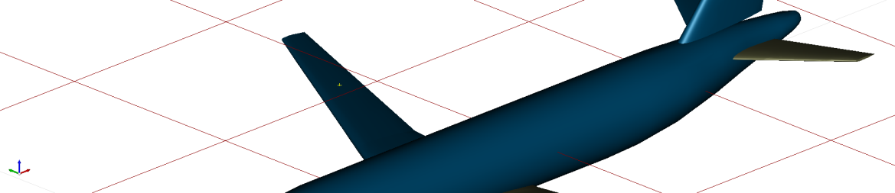

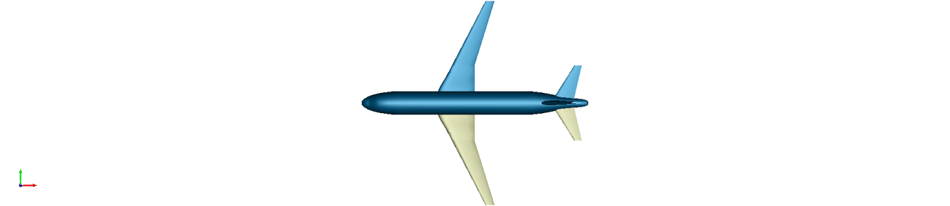
Some examples how to use the TiGL Viewer Scripting API:
Compute and draw point on wing:
Draw the first wing:
Show top view and fit screen:
Make a screenshot
Hint: Type help(tigl) to get a list of available TiGL functions.
Hint: Type help to display this information in the Console.
>> p = tigl.wingGetUpperPoint(1, 3, 0.5, 0.5); >> drawPoint(p);
>> uid = tigl.wingGetUID(1); >> drawShape(tigl.getShape(uid));
>> app.viewer.viewTop(); >> app.viewer.fitAll();
>> app.viewer.makeScreenshot('image.png'); //PNG image, white background >> app.viewer.makeScreenshot('image.jpg', false); //JPEG image, current background

Slide 7
tigl, app, viewer and scene
The API consists of four javascript objects and a few global definitions (e.g. a Point3d class)
tigl
A selection of the basic TiGL API functions
app
Open CPACS files or TiGLViewer Scripts, close the application, get the viewer and scene objects
Derived from Qt’s QMainWindow class
app.viewer
Change the camera position, zoom, pan, make screenshots…
Derived from Qt’s QWidget class
app.scene
Display objects, turn grid on and off, change the objects appearance, draw points and vectors, …

Slide 8
The TiGL Interface tigl class provides the following methods:
getWingCount()
getVersion()
componentGetHashCode(componentUID)
exportComponent(uid, filename, deflection)
exportConfiguration(filename, fuseAllShapes, deflection)
exportFusedWingFuselageIGES(filename)
exportIGES(filename)
exportSTEP(filename)
exportFusedSTEP(filename)
exportMeshedFuselageSTL(fuselageIndex, filename, deflection)
exportMeshedFuselageVTKByIndex(fuselageIndex, filename, deflection)
exportMeshedFuselageVTKByUID(fuselageUID, filename, deflection)
setExportOptions(exporter, optionName, optionValue)
fuselageGetUID(fuselageIndex)
fuselageGetCircumference(fuselageIndex, segmentIndex, eta)
fuselageGetPoint(fuselageIndex, segmentIndex, eta, zeta)
fuselageGetSegmentUID(fuselageIndex, segmentIndex)
fuselageGetSegmentVolume(fuselageIndex, segmentIndex)
getFuselageCount()
fuselageGetSegmentCount(fuselageIndex)
wingGetUpperPoint(wingIndex, segmentIndex, eta, xsi)
wingGetUID(wingIndex)
wingGetLowerPoint(wingIndex, segmentIndex, eta, xsi)
wingGetUpperPointAtDirection(wingIndex, segmentIndex, eta, xsi, dirx, diry, dirz)
wingGetLowerPointAtDirection(wingIndex, segmentIndex, eta, xsi, dirx, diry, dirz)
wingGetChordPoint(wingIndex, segmentIndex, eta, xsi)
wingGetChordNormal(wingIndex, segmentIndex, eta, xsi)
wingComponentSegmentGetPoint(compSegUID, eta, xsi)
wingGetSegmentCount(wingIndex)
wingGetSegmentUID(wingIndex, segmentIndex)
wingGetSpan(wingUID)
wingGetSegmentVolume(wingIndex, segmentIndex)
getErrorString(errorCode)
getShape(uid)
The following properties are defined:
version
>> help(tigl)

Slide 9
The TiGL Viewer Application class app provides the following methods:
windowInitialized()
openFile(fileName)
openScript(scriptFileName)
saveFile(fileName)
closeConfiguration()
getViewer()
getScene()
getDocument()
The following properties are defined:
viewer
scene
+ some additional Qt related functions and properties
>> help(app)

Slide 10
The TiGL Viewer Application class app.viewer provides the following methods:
initialized()
selectionChanged()
mouseMoved(X, Y, Z)
pointClicked(X, Y, Z)
sendStatus(aMessage)
error(errorCode, errorDescription)
idle()
fitExtents()
fitAll()
fitArea()
zoom()
zoomIn()
zoomOut()
zoom(scale)
pan()
globalPan()
rotation()
selecting()
hiddenLineOn()
hiddenLineOff()
setBackgroundGradient(r, g, b)
setBackgroundColor(r, g, b)
setBGImage(QString)
viewFront()
viewBack()
viewTop()
viewBottom()
viewLeft()
viewRight()
viewAxo()
viewTopFront()
viewGrid()
viewReset()
setLookAtPosition(x, y, z)
setCameraPosition(x, y, z)
setCameraPosition(elevationAngleDegree, azimuthAngleDegree)
setCameraUpVector(x, y, z)
setReset()
setTransparency()
setTransparency(int)
setObjectsColor()
setObjectsMaterial()
setObjectsTexture()
makeScreenshot(filename, whiteBGEnabled, width, height, quality)
makeScreenshot(filename, whiteBGEnabled, width, height)
makeScreenshot(filename, whiteBGEnabled, width)
makeScreenshot(filename, whiteBGEnabled)
makeScreenshot(filename)
+ some additional Qt related functions and properties
>> help(app.viewer)

Slide 11
The TiGL Viewer Application class app.scene provides the following methods:
error(errorCode, errorDescription)
displayShape(pshape, updateViewer, color, transparency)
displayShape(pshape, updateViewer, color)
displayShape(pshape, updateViewer)
displayShape(loft, updateViewer, color, transparency)
displayShape(loft, updateViewer, color)
displayShape(loft, updateViewer)
drawPoint(x, y, z)
drawVector(x, y, z, dirx, diry, dirz)
deleteAllObjects()
gridXY()
gridXZ()
gridYZ()
toggleGrid(bool)
gridOn()
gridOff()
gridRect()
gridCirc()
wireFrame(bool)
selectAll()
eraseSelected()
setTransparency(tr)
setObjectsWireframe()
setObjectsShading()
setObjectsMaterial(material)
setObjectsTexture(filename)
setReflectionlinesEnabled(bool)
setObjectsColor(color)
>> help(app.scene)

Slide 12
CAD Exports
The standard TiGL API functions can be used for CAD exports
New in TiGL 3: You can set options for the exporter using
setExportOptions(exporter, optionName, optionValue)
exporter is one of “brep“, “collada“, “iges“, “step“, “stl“, “vtk“
optionName is one of “IsDefault”, “ApplySymmetries”, “IncludeFarfield”, …
optionValue depends on the optionName (can be bool, int, float)
The different exporters have different additional options and different default values.

Slide 13
Default values for the CAD export options
 | BREP | Collada | IGES | STEP | STL | VTK
ApplySymmetries | false | true | false | false | true | true
IncludeFarfield | false | false | true | true | false | false
ShapeGroupMode | WHOLE_SHAPE | WHOLE_SHAPE | NAMED_COMPOUNDS | NAMED_COMPOUNDS | WHOLE_SHAPE | WHOLE_SHAPE
IGES5.3 | x | x | true | x | x | x
WriteNormals | x | x | x | x | x | true
MultiplePieces | x | x | x | x | x | false
WriteMetaData | x | x | x | x | x | true

Slide 14
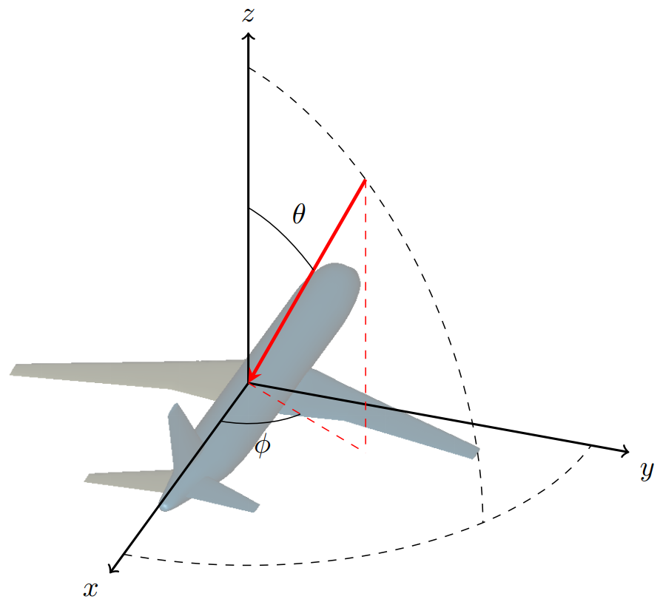
Camera Positioning
Camera Positioning can be manipulated via
app.viewer.setLookAtPosition(x,y,z)
app.viewer.setCameraUpVector(x,y,z)
and either
app.viewer.setCameraPosition(x, y, z)
app.viewer.setCameraPosition(elevationAngleDegree,
azimuthAngleDegree)
Setting Camera Position using spherical coordinates keeps the distance to the LookAtPosition constant
Create animations using a for-loop:
for (i = 0; i < numFrames; i += 1) {
// reset theta and phi here
app.viewer.setCameraPosition(theta, phi)
app.viewer.makeScreenshot(“frame_” + i + “.jpg");
}

Slide 15
Hands On

Slide 16
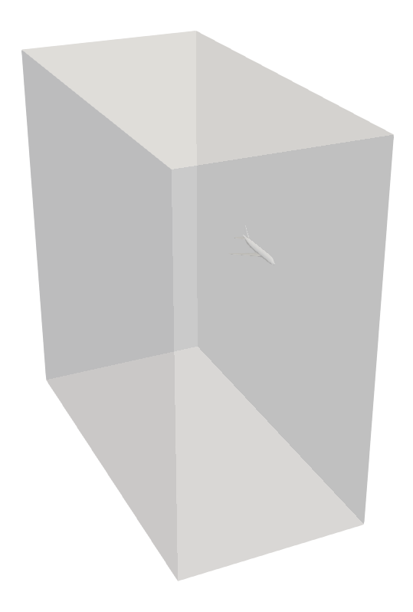
Task 1: Customized VTK export
Write a script that
Opens the file “D150_farField.xml”,
(get the file from here: https://goo.gl/tMHMU3 )
Sets the options for the VTK-export, so that the far field is included and symmetries are not applied,
Exports the configuration to a vtk file using a maximum deflection of 0.1 for the triangulation,
Closes TiGLViewer.
Hint:
Start TiGlViewer from the console in the directory of the input file using the “--script” option.

Slide 17
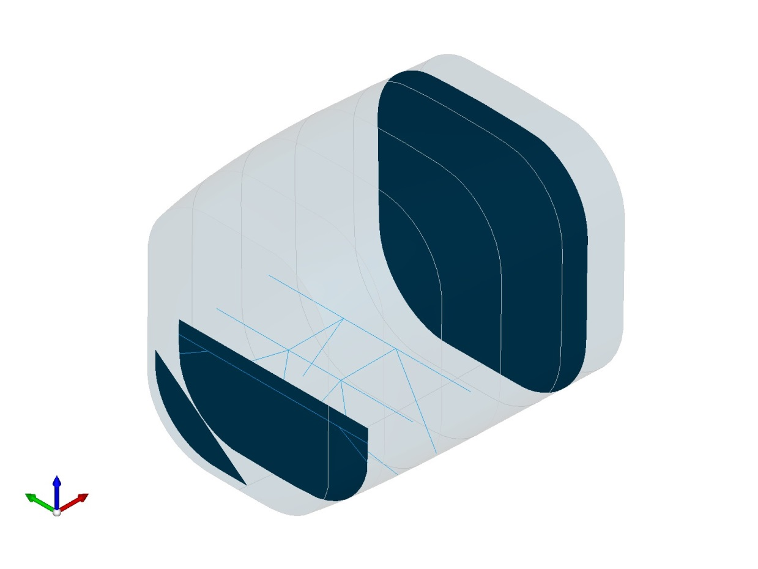
Task 2: Display subshapes and make a screenshot
Write a script that
Opens the CPACS file “fuselage_structure-v3.xml”,
(get the file from here: https://goo.gl/vm4HXp )
Sets the transparency of all objects to 90
Displays the shapes with the following uids
Makes a screenshot
"cargoCrossBeam1" "cargoCrossBeam2" "cargoCrossBeam3" | "cargoCrossBeamStrut1" "cargoCrossBeamStrut2" "cargoCrossBeamStrut3" "cargoCrossBeamStrut4" "cargoCrossBeamStrut5" "cargoCrossBeamStrut6" "cargoCrossBeamStrut7" "cargoCrossBeamStrut8" | "half_bulkhead" "holed_bulkhead„ "simple_bulkhead" | "longFloorBeam1" "longFloorBeam2"

Slide 18
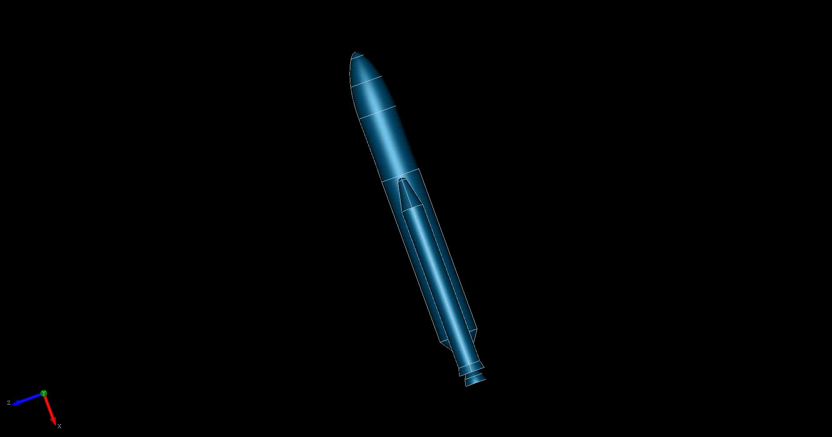
Task 3: Make an animated video
Replicate the Ariane-5 video from this slide. To do so,
Unzip the file ariane.zip from the exercise directory.
Fill in the missing code in the ariane-movie.js script (search for “EXERCISE” in the comments)
(OPTIONAL) If you have FFMPEG (https://www.ffmpeg.org/ ) installed, open a terminal/command-prompt and type
(see https://goo.gl/SW8mZR )
ffmpeg –r 25 –f image2 -s 1874x816 –I image_04d.jpg –vcodec libx264 –crf 15 –pix_fmt yuv420p ariane.mp4

Slide 19
Final Remarks

Slide 20
Final Remarks
The main purpose of the TiGL Viewer Scripting API is quick debugging and customized visualization
We add new functionality every now and then as new applications come to our minds
Outlook:
Manipulate individual objects in the scene
Change material and color of the objects
If you use the TiGL Viewer Scripting API and find that useful functions are missing, please let us know!

Slide 21

Questions
jan.kleinert@dlr.de
martin.siggel@dlr.de

